Slide 1
Organizing Information for Your Readers
C H A P T E R 6

Slide 2
Presentation Overview
How Do You Organize a Document?
  What about Readers Should You Consider?
  What about Workplace Context Should You Consider?
  What Are the Standard Patterns of Organization?
  How Do You Create an Outline?
  What Is Parallelism?

Slide 3
Presentation Overview
  How Do You Make Your Organization Visible?
How Do You Select a Standard Pattern of Organization?

Slide 4
How Do Organize a Document?
Consider your readers.
Consider your workplace context.
Use standard patterns of organization.
Outline your information.
Make the organization visible.

Slide 5
What about Readers Should You Consider?
Can I put important information at the beginning of the document?
Can I order the information from the simplest to the most complex, the easiest to the most difficult, or the most familiar to the least familiar to clarify it for readers?
Will readers scan the document or read it selectively?
Can I begin with the least controversial or surprising information and move to the most controversial or surprising?

Slide 6
What about Workplace Context Should You Consider?
How will my manager want me to organize the information?
Does my organization have a predetermined organization for similar documents?

Slide 7
What Are the Standard Patterns of Organization?
Spatial order
Chronological order
General-to-specific order
Classification
Partition
Comparison and contrast
Problem and solution
Cause and effect
Order of importance

Slide 8
How Do You Outline Your Information?
Informal outline
  A list of initial thoughts and pieces of information written without necessarily being organized, parallel, or in complete sentences
Formal outline
  A list of ideas that establishes a hierarchy of information by using numbered or lettered topics and subtopics and parallel structure

Slide 9
Informal Outline
Topic: Theories on the Cause
of Autism
first thought that mothers who withheld affection caused it
remains controversial whether vaccines play a part
theories on environmental causes include everything from viral infections to rain!
largely heritable, according to studies
could it be that a person has a genetic predisposition toward it and then something in that person’s environment triggers its development?

Slide 10
Formal Outline
Topic: Theories on the Cause
of Autism
Genetic
Environmental
  “Refrigerator mothers” (refuted)
  Vaccines
  Exposure to toxins
  Metabolic imbalance
  Autoimmune disease
  Viral infection
  Oxidative stress
  Rain
  Television watching
  Ultrasounds
Combination
  Predisposition to autism and an environmental trigger

Slide 11
What Is Parallelism?
In mathematics, it refers to two lines of the same slope.
                y=1/2x+1
                y=1/2x
y
x

Slide 12
What Is Parallelism?
In language, it refers to similar grammatical structures.
  Not parallel: The inmates amused themselves with checkers, weights, and hatched escape plans.
  Parallel: The inmates amused themselves with checkers, weights, and escape plans.
  The inmates amused themselves by playing checkers, lifting weights, and hatching escape plans.

Slide 13
What Is Parallelism?
In language, it refers to similar grammatical structures.
  Not parallel: Prison guards must be able to follow and enforce rules, observe unusual behaviors, and to act quickly in an emergency.
  Parallel: Prison guards must be able to follow and enforce rules, observe unusual behaviors, and act quickly in an emergency.

Slide 14
What Is Parallelism?
Topic: Backcountry Cooking Guide
Planning Meals
  Number of days in camping trip
  Number in party
  Nutrition and other diet considerations
  Weight
  Ease of preparation
Supplies
  Food
    Utensils and equipment
III. Packing
  Measure and weigh
  Package and insulate
  Place in backpack
IV. Preparation
  Snack recipes
  Breakfast recipes
  Cooking main dishes
  Side dish recipes
  Dessert recipes

Slide 15
What Is Parallelism?
Topic: Backcountry Cooking Guide
Planning Meals
  Number of days in camping trip
  Number in party
  Nutrition and other diet considerations
  Weight
  Ease of preparation
Gathering Supplies
  Food
    Utensils and equipment
III. Packing
  Measure and weigh
  Package and insulate
  Place in backpack
IV. Preparing Meals
  Snack recipes
  Breakfast recipes
  Main dish recipes
  Side dish recipes
  Dessert recipes

Slide 16
How Do You Make Your Organization Visible?
Use headings
Use a detailed, accurate table of contents
Use topic sentences at the beginning of each paragraph
Use overviews at the beginnings of documents, chapters, and sections

Slide 17
How Do You Make Your Organization Visible?
Document without Visible Organization
Document with Visible Organization
When a document doesn’t have headings, readers may have difficulty determining how the writer has organized the ideas in that document. Having a sense of the structure used gives readers a basis for understanding the ideas. Headings also help readers more easily skim through information to find what they need. Readers have to go through every line of text whenever a document doesn’t have headings.
Headings are beneficial in many ways.
Sense of Structure
When a document doesn’t have headings, readers may have difficulty determining how the writer has organized the ideas in that document. Having a sense of the structure used gives readers a basis for understanding the ideas.
Ease in Scanning
Headings also help readers more easily scan through information to find what they need. Readers have to go through every line of text whenever a document doesn’t have headings.

Slide 18
How Do You Select a Standard Pattern of Organization?
Spatial order
Chronological order
General-to-specific order
Classification
Partition
Comparison and contrast
Problem and solution
Cause and effect
Order of importance

Slide 19
Spatial Order
Pattern of organization used to describe objects, devices, or physical locations
  Left to right
  Top to bottom or vice versa
  Inside to outside

Slide 20
Spatial Order
Natural History Museum
Lower Level
Land and Sea
Dinos
The Evolution of Man
Food Court
1st Floor
Butterfly Conservatory
Wing It
Gift Shop
2nd Floor
Special Exhibits
Theater
3rd Floor
Extreme Environs
Gems and Minerals
4th Floor
Hands-On Science
Planetarium

Slide 21
Chronological Order
Pattern of organization based on order of occurrence or sequence
Directions to the Museum
From the North
Take I-90 to Exit 13, Archimedes Avenue.
Turn left onto Archimedes Avenue.
Turn right onto Darwin Drive.
The museum will be on your left.

Slide 22
General-to-Specific Order
Pattern of organization beginning with general information about a topic before moving to specific information
Land and Sea
Amphibians are creatures that spend part of their time on land and part of their time in water. The “Land and Sea” exhibit presents live specimens of some of the most well known amphibians, including frogs, toads, and salamanders. Come learn what it means to be an amphibian!

Slide 23
Classification
Pattern of organization that groups items into broad categories or subcategories
Classes of Flowers
Bulbs
Tubers
Herbaceous perennials
Biennials
Annuals

Slide 24
Partition
Pattern of organization based on the division of an item into its individual parts

Slide 25
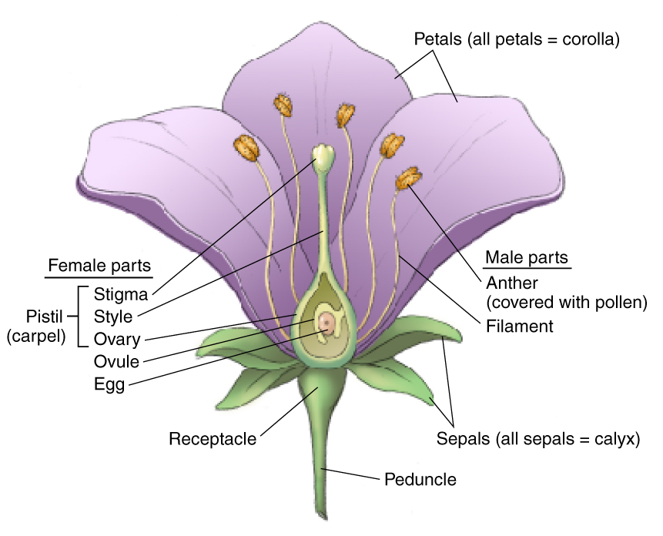
Partition
Parts of a Flower

Slide 26
Comparison and Contrast
Pattern of organization according to options available or criteria used to compare and contrast these options

Slide 27
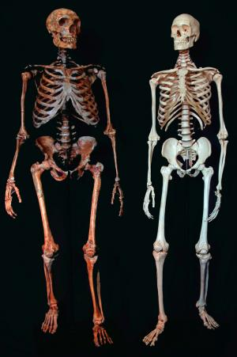
Comparison and Contrast
Options
Neanderthals
Modern humans
Criteria
Skull
Brow
Nose
Jaw
Teeth
Chin
Collarbone
Shoulders
Fingers
Ribcage
Pelvis
Legs
Source: Downloaded from the World Wide Web, April 1, 2009:
http://www.msnbc.msn.com/id/7153332/. John Wiley & Sons Inc.

Slide 28
Problem and Solution
Pattern of organization that presents problems and the solution(s) to those problems

Slide 29
Problem and Solution
Proposal to Initiate a Temporary Discount Program for Weekday Visitors
Introduction
Problems
  Low attendance on weekdays
  Operating expenses more than revenue
  Employee complaints about reduced number of hours they are scheduled to work
Solution: a 10% discount for all visitors on weekdays during the month of August
  Proven attendance boost and marketing opportunity
  More revenue from increased sales, with negligible loss from discount
  More hours for employees
Conclusion

Slide 30
Cause and Effect
Pattern of organization that moves from the causes to the effects (or consequences) of a particular action or series of actions, or vice versa

Slide 31
Cause and Effect
Causes of Deforestation
Effects of Deforestation
Population growth in urban areas and developing countries
Mining
Oil and gas drilling
Logging
Farming, especially the “slash and burn” technique
Cattle grazing
Dams
Erosion
Flooding
Drought
Loss of biological diversity
Climate change

Slide 32
Order of Importance
Pattern of organization that moves from the most important to the least important information, or vice versa

Slide 33
Order of Importance
Summary of Museum Improvement Plan
The plan involves . . .
building a new wing to house “North American Fauna and Flora” exhibit and greenhouse
redesigning the landscaping on the museum grounds
expanding parking lot on the south side of the museum, along Darwin Drive
adding storage vaults for artifacts
remodeling bathrooms
replacing signage system

Slide 34
Questions?

