Slide 1
New National Titles
January 2021

Slide 2
The Process
Continue to call on the courses that bear the proper enrollments for traditional KH projects.
Solutions 2 & 3 are fall back options.
Do not change your preplans to call on small courses for adoption purposes.
Solution 3 is meant to be the proper answer for anyone not interested in doing any writing. START THE RELATIONSHIP.
Ask the question “what other courses do you teach?” This will lead you to the smaller adoption or another potential project. See above…….

Slide 3
The Pivot
After exhausting your quest for an author-developed product, no desire to write nor customize…….
You have developed needs use those needs to move them to an adoption….”we have a great Public Speaking book.”
Send it to them using the VS comp copy request on the 3rd solution site.
Schedule a follow-up….continue the interview.
Re-interviewing may lead them back to a 1 or 2 because it gives them additional time to think.
If there is still no interest, close the adoption. After using the book for a semester, continue the follow-up process and at that time they may be ready to go to further.

Slide 4
Please use CRM
If you don’t add your prospects to your CRM it causes issues.
If the prospect is not in CRM lines are being crossed amongst our sales channels and it confuses the customer.

Slide 5
National Products are designed to:
Be able to be sold to most professors who still want the easiest solution.
Be created by in-the-classroom writers.
Be well-known in their discipline.
Be reviewed prior to publication.
Be complete with quality ancillary programs.
Have quality content that can be used for customization.
Be the entryway into developing a relationship.

Slide 6
Biology
*Majors Biology
*Book divided into 3 volumes- full version, Bio 1 and Bio 2.
*Accompanied by Area 9 site.
*https://he.kendallhunt.com/product/biology-life-we-know-it-0
*PowerPoints and testbank available.

Slide 7
Earth Science
*Developed for an Introductory Meteorology Course.
*Developed to National Science Education Standards and the Scientific Method.
*PowerPoints and Testbank available.

Slide 8
Criminal Justice
*Comes with PowerPoint slides, dataset exercises and video interviews.
*End of chapter exercises to apply the chapter pedagogy.

Slide 9
Criminal Justice
*Developed by an authoring group that are both educators and criminal justice professionals.
*Its core aim is to answer the “Why” behind the actions of serial killers of the past, highlighting theoretical explanations grounded in a diverse field of social sciences: anthropology, psychology, economics sociology, and criminology.
*PowerPoint slides available

Slide 10
Criminal Justice
*Authors from two of the most respected Victimology programs in the country- U of Baltimore and U of New Haven and are nationally known experts in the field.
*Has testbank and PowerPoint slides in progress.

Slide 11
Criminal Justice
*Examines such topics as police use of force, implicit bias, delinquency, women in non-US prisons, domestic violence, LGBTQ+, cybersecurity and women in CJ leadership.
*Is and edited volume with contributions from a multidisciplinary approach.
*Testbank and PowerPoints.

Slide 12
Criminal Justice
*All of the authors have worked in CSI (two currently are active (Boone and McGill) investigators so this is both research based and practical.
*A Virtual Reality program for students to practice and be assessed on will be ready for fall.

Slide 13
Criminal Justice
*Areas include the dark web drug scene, hiring a hitman, deep areas of the “infamous” Red room, hackers, and hacktivists.
*This book serves as a proverbial travel guide into the sick and twisted side of the dark web, including hidden coves for illegal activity.

Slide 14
Criminal Justice
Discusses differences between identifying smuggling vs. trafficking and the various forms of trafficking, such as sex trafficking vs. forced labor.
Topics include Internet & trafficking, gangs, social media, recruiting locations & techniques, nail, massage, and other service industries and how they operate, and what potential indicators may reveal victims or traffickers themselves.
A look into the policies and statutes covering human trafficking.
Testbank and PowerPoints

Slide 15
Criminal Justice
*Examines the flawed policies and practices that contribute to the disparate treatment of minority group members. A solutions oriented text, Race, Crime, and Justice includes “Did you know?” scenarios and links to sites designed to inform and to provoke thought about the realities of race, crime, and justice.
*Testbank

Slide 16
Law
*Book is designed for any class that needs to prepare to prepare a case as a legal expert in a court case.
*Comes with Go React software so that students can present in any classroom format and be assessed.

Slide 17
Business/Management
*Contains descriptions of many of the practices routinely performed by managers in various types of organizations. Students will be presented with common management theories based on academic research and the research done by leading consulting firms such as McKinsey and Boston Consulting Group.
*A “You Be the Manager” section which provides a list of activities for students to perform either individually or with a team in a semester-long case.
*Testbank, PowerPoints and video lectures.
*Available in Area 9 format for fall integrates into LMS.

Slide 18
Sport Management
*The book is the only text to discuss the metrics that are critical to an analytical understanding of contemporary sport.
*The book combines discussion of these metrics with practical examples in R of how to calculate these metrics, providing readers with valuable data analysis skills;
the book emphasizes the metrics in context and teaches the game-theoretic aspects and backdrop of sport analytics—understanding sport analytics through the lens of decision making theory for all major American sports.
*Datasets, testbank, PowerPoints

Slide 19
Sport Management
*Covers the finances of the following sports: NFL, NBA, MLB, NHL, MLS, Women’s Sports, Olympic Games, FIFA College Sports, Niche Sports, Summary and Future Trends.
*Each sport is discussed using the following indicators: Facility costs and public/private partnerships
Salary caps and structure
League revenue sharing
Event and amenity expenditures
Media contracts
Administrative Overhead/ Finances
*Testbank and PowerPoints

Slide 20
Business
*Integrates the vast literature in consumer behavior and quantitative marketing on when, how, and why advertising works, in the new environment of social media.
*Author from USC top advertising schools in country.
*Testbank, case studies and PowerPoints.

Slide 21
Business/HR
*Provides an interactive module to the topic of job evaluation.
*Includes major discussions on performance management, motivation, internal communication and payroll linkage.
*Testbank and PowerPoints.

Slide 22
English
*It features writers from diverse racial, geographic, and socioeconomic backgrounds.
*Each selection includes introductory headnotes providing biographical information about the writer and pointing at one or two unique formal or thematic features, followed by writing prompts designed to move writers past fear of the blank page.
*IM

Slide 23
English
*For use in a standard Comp 1 course. Diverse and engaging readings.
*Encourages students to engage in public discourse, the lost art of meaningful conversation. These “conversations” take place in writing, language composed in accordance with the guidelines of standard written English. Written to address Millennials and Generation Z born and raised in the information age, Engaging Discourse is a collection of collection of classic and contemporary readings, assignments, and resources.
*Working on assessments.

Slide 24
English
*Developed for the Comp 2 course.
*Be extremely careful when offering customization to these readers. You’ll have to reclear permissions and they were VERY expensive to produce.

Slide 25
Hospitality
*Discussions on topics such as Accountability and Control, Restaurant Menu Selection and Pricing, Budgeting, Recordkeeping and Operational Expenses. NEW topics, such as Selling Alcoholic Beverages, Guest Expectations, Technology and Suggestive Selling.
*Videos, testbank, PowerPoint slides and IM.
*Walker is the top selling author in the Hospitality industry. Takeover from Pearson.

Slide 26
Hospitality
*Takeover from Pearson. Top selling book in niche. Fenich most recognized name in discipline.
*Inclusion of COVID-19 impacts on all of the sectors of the MEEC industry.
*Chapter on technology has been significantly re-written and updated.
*Testbank and PowerPoint slides

Slide 27
Hospitality
*A "role-play" workbook of detailed sales scenarios, allowing students to practice sales concepts as they learn them.
*Has Go React so that students can record their sales presentations for assessing and will work in any type classroom.
*Testbank and PowerPoints.

Slide 28
Communication
*Takeover from Pearson. Author (Beebe) #1 bestseller in Public Speaking, Interpersonal and Business and Professional Communication markets.
*Top seller in it’s niche.
*PowerPoints, testbank and comes with GoReact.

Slide 29
Communication
*Workbook developed to go with any Communication Ethics textbook.
*Instructor Guide with Quiz questions developed.

Slide 30
Communication
*Includes tips from experienced experts on the field on how to handle scenarios and relations between practitioners and journalists / media.
Describes how to conduct media interviews, presents theoretical application, and how to apply these concepts to stress fueled crisis communication scenarios.

Slide 31
Communication
*Takeover from Pearson for 4th edition.
*Testbank and PowerPoint presentations.

Slide 32
Communication
*GRL only product. Can integrate with any LMS.
*Explains how students can manage their fears and anxieties about speaking and be able to adapt to culturally diverse audiences.
*Jennifer Waldeck current president of ECA.
*Testbank ,PowerPoint slides and Go React software..

Slide 33
Communication
*GRL only product. Can integrate with any LMS.
*The package includes sixteen On the Job Interactive Experiences that provide students an opportunity to experience additional current, research-based, practical, and useful information at their own pace.
*Jennifer Waldeck current president of ECA.
*Testbank and PowerPoint slides.

Slide 34
Communication
*GRL only product. Can integrate with any LMS.
*Developed for the two-year market.
*Introduces group theory and practice with an emphasis on application including guides to virtual group communication. The online course package provides ongoing case studies demonstrating the chapter material in a traditional classroom group, as well as a workplace group
*Testbank,PowerPoint slides, quizzes and recorded lectures.

Slide 35
Communication
*Authors from top programs UT Austin and U of Illinois. Knapp one of the biggest names in the field.
*Expanded coverage of social media, new communication technologies, cross-sex friendships; and additional information about affectionate communication and health in relationships. New information about the phenomenon of “on-again/off-again” relationships.
*Testbank, PowerPoint slides, KHQ.

Slide 36
Communication
*Uncovers tactics to learn how to love better and maintain that love in all relationships—with friends, family, romantic interests, and even oneself.
*Developed at a faith-based institution.
*Showcased as a “short course” at last two NCA’s.
*Testbank and PowerPoint slides.

Slide 37
Communication/Mkting
*Integrates the three foundational IMC documents—consumer profile, creative brief and media plan. Identifies critical metrics for digital tools: digital display ads, content marketing, ecommerce, email, experiential marketing, mobile, search, social, social analytics, streaming audio/video, traditional media and websites. Covers timely topics such as: AI, brand purpose, digital voice assistants and PR’s shift to social media.
*Testbank, PowerPoints and blog.

Slide 38
Products with Area 9
Baldwin-Majors Biology
McKenney-Botany
Allred- Nutrition
Rauber-Meteorology (for fall)
Hamilton-Intro to Management (for fall)

Slide 39
Pipeline Projects
Velasco-Small Business Management F’21
Zehr-Entrepreneurship
Flohr-Project Management in Hospitality
Nagel- E Sports
Sildorff- Human Physiology
Shahady- Freshwater Ecology
Blau- Small Group Communication
Rande- Intro to Beverages
Taylor- Restaurant Operations

Slide 40
Pipeline Projects Continued
Umesiri-Organic Chemistry- F’22
Shmaefsky- Environmental Science
Rao- Intro to Financial Management

Slide 41
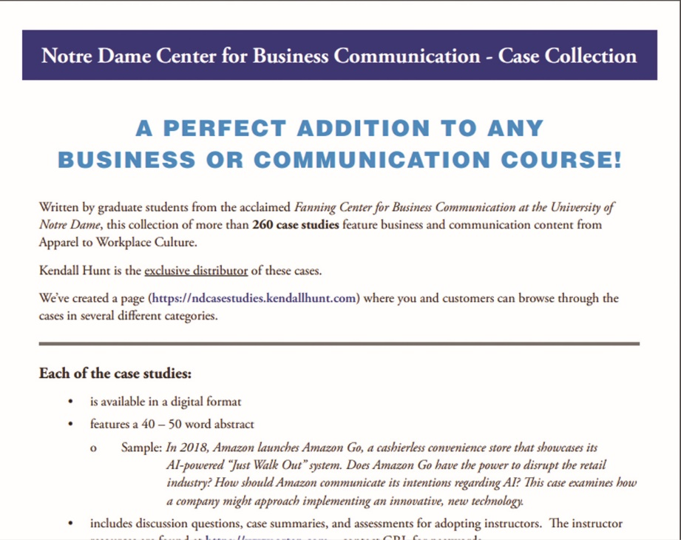
Notre Dame Case Studies

