Slide 2
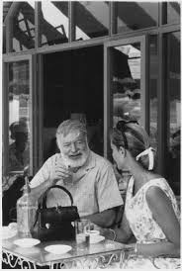
Todays Outcomes
Discuss KH Sales Strategy
NCA
New Available Product
What’s in the pipeline
Making the MOST out of an Adoption
Bring Home the Sales
Adoption Champions

Slide 3
KH Sales Philosophy

Slide 4
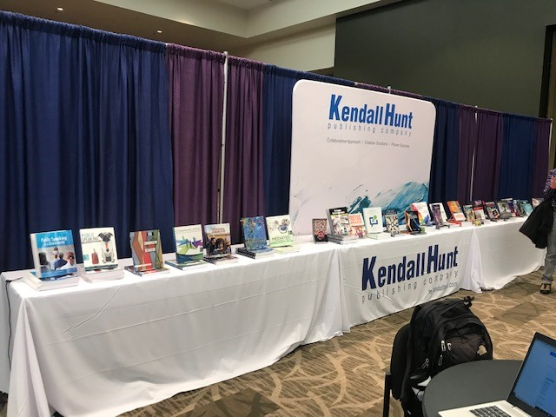
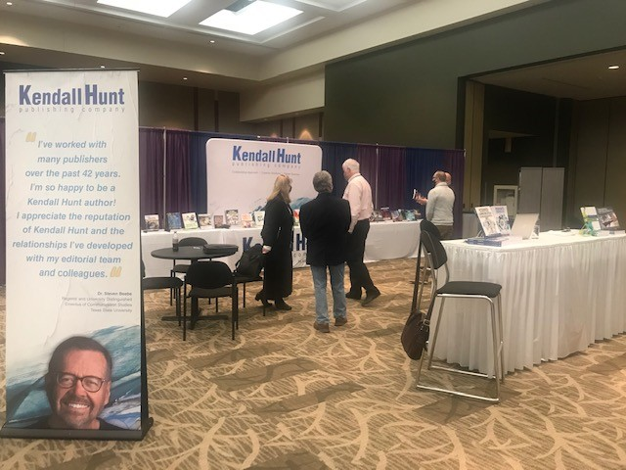
NCA
119 Leads
$833,370

Slide 5
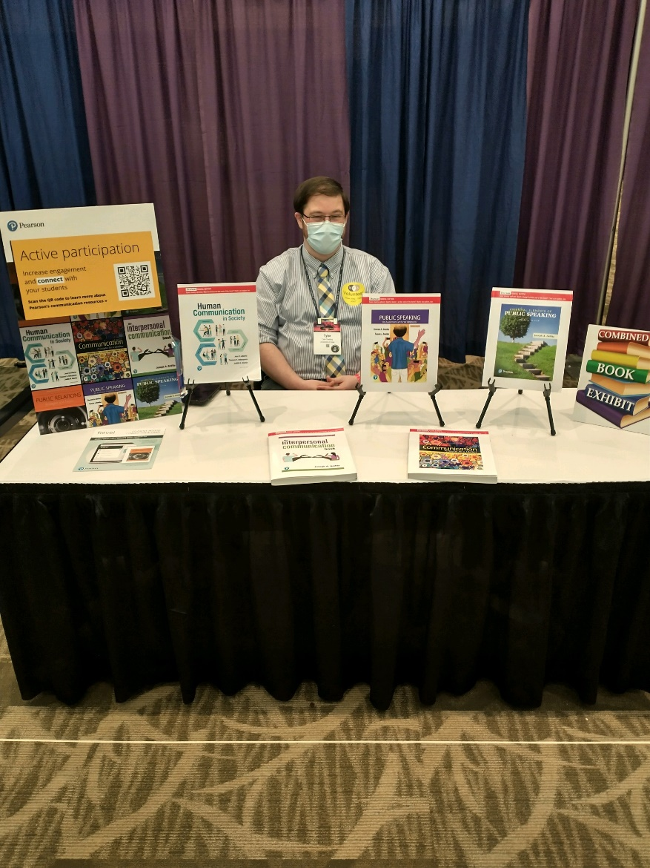
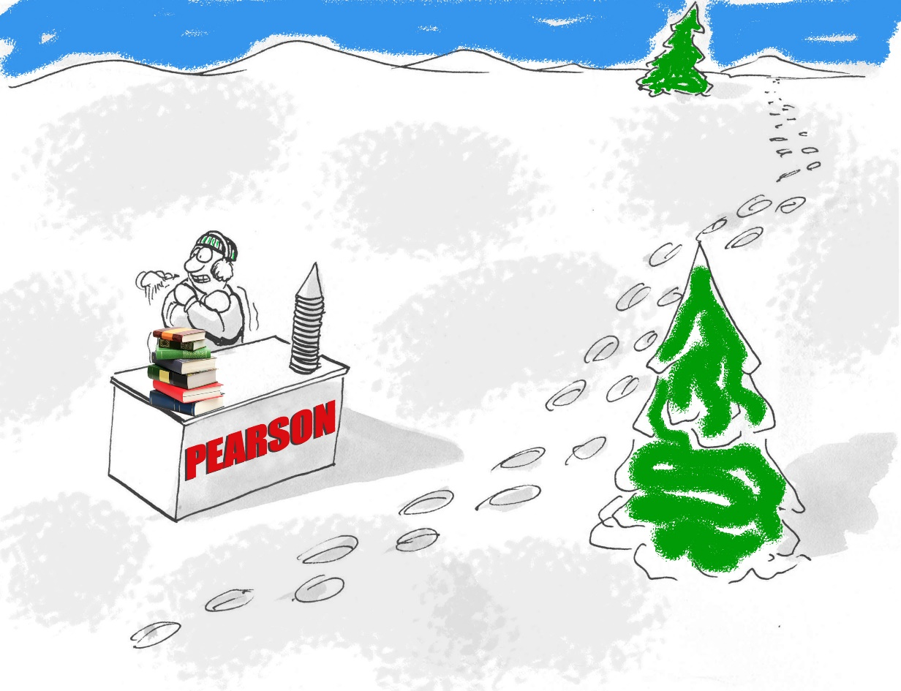
Pearson

Slide 6
Business
The need for trusted and effective leaders is essential to creating a new era for inclusivity and innovation. As an experienced thought partner, Khan moves in spaces of influence to strike the right connections between teams and the global communities they serve, making his book an incredible resource for any leader of today. Craig Williams, President, JORDAN Brand, Nike

Slide 7
Business
Compensation

Slide 8
Business
Small Business Management for Non-Profits

Slide 9
Business
Sport Analytics- Co Author of Sport Law

Slide 10
Business
Sport Finance- Edited by Experts

Slide 11
Business
Sport Entrepreneurship

Slide 12
Communication
GRL ONLY

Slide 13
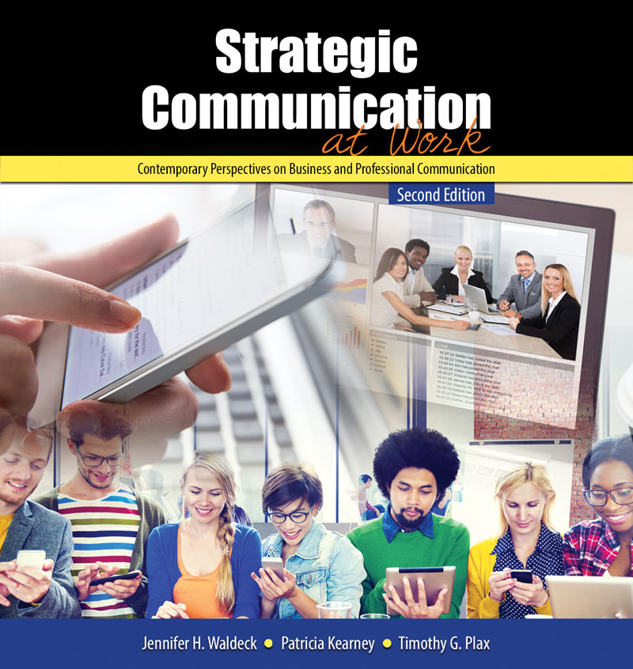
Communication
GRL ONLY

Slide 14
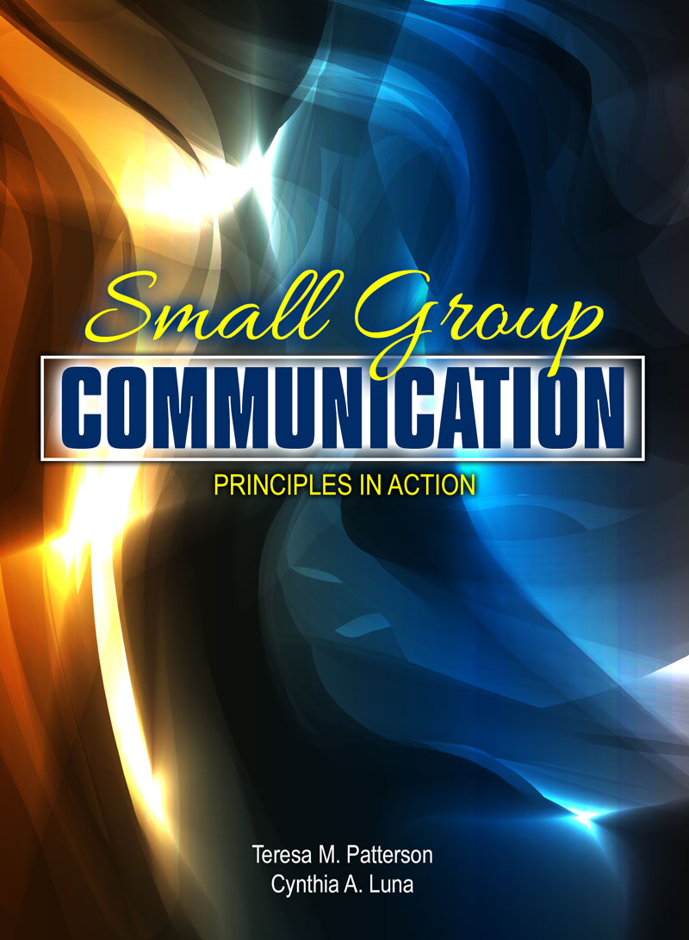
Communication
I have used several different group communication textbooks over the years and have found that Small Group Communication: Principles in Action is by far the best fit for my students and for me.
Amanda Mason, Fresno City College
GRL ONLY

Slide 15
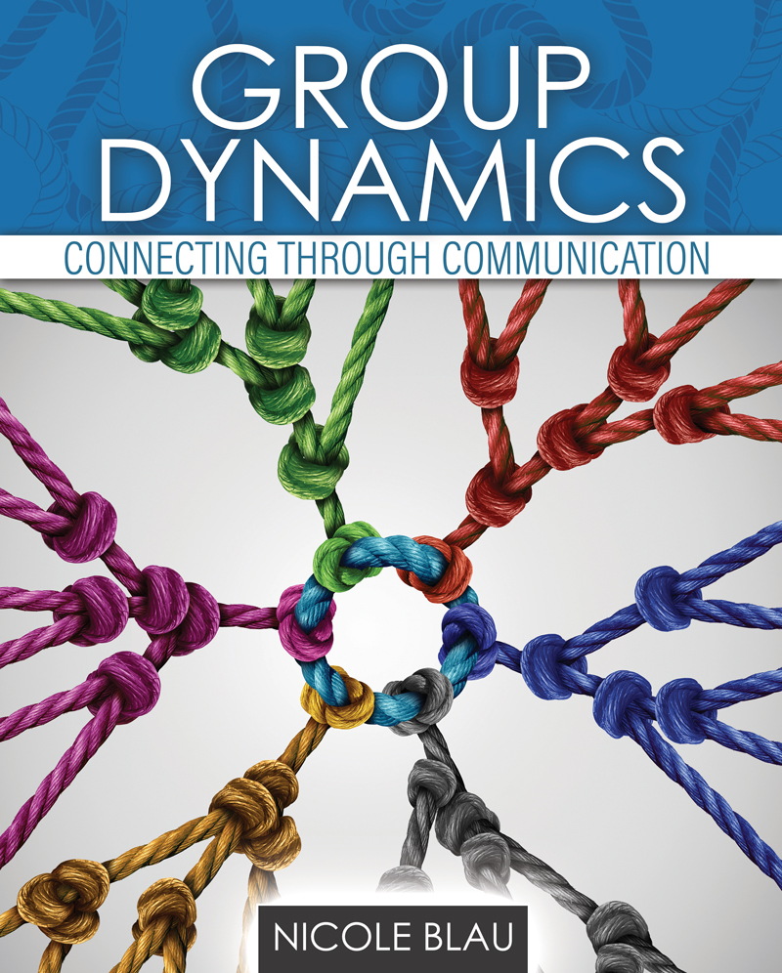
Communication
Group Communication

Slide 16
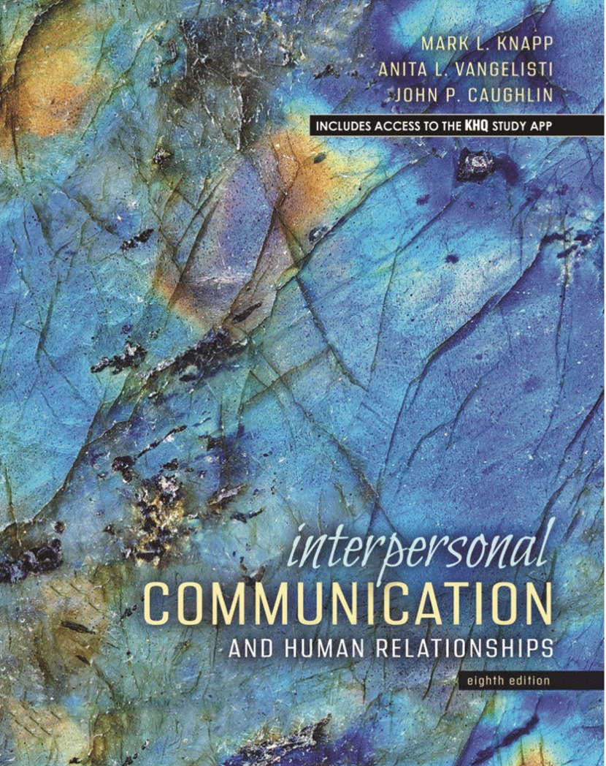
Communication

Slide 17
Communication

Slide 18
Communication
Steven Beebe is the top selling author in the Communication field.
https://www.youtube.com/watch?v=PdBifXJbGQs

Slide 19
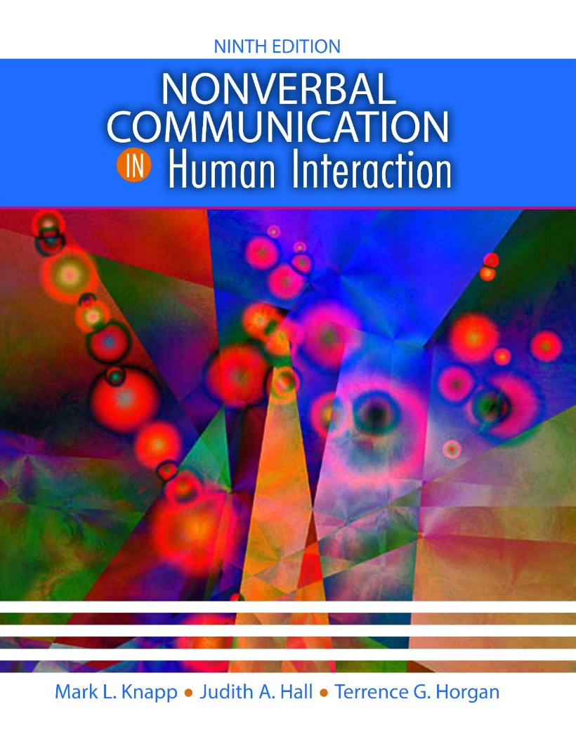
Communication
2022 marks the 50 year anniversary of the publication of this book.

Slide 20
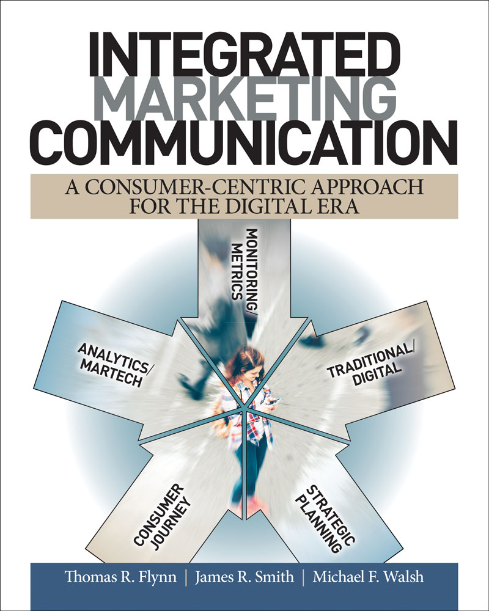
Communication
In addition to being a comprehensive college textbook, it’s also an industry text for professionals.
Anthony Palomba, University of Virginia
Integrated Marketing Communication: A Consumer-Centric Approach for the Digital Era is extremely valuable because it combines the expertise and experience of three authors with different backgrounds. They have created a book that combines theory, industry terminology and the latest trends in marketing and advertising from an industry-insider's perspective.
Karen Myers, UC Santa Barbara

Slide 21
Communication
Communication Ethics

Slide 22
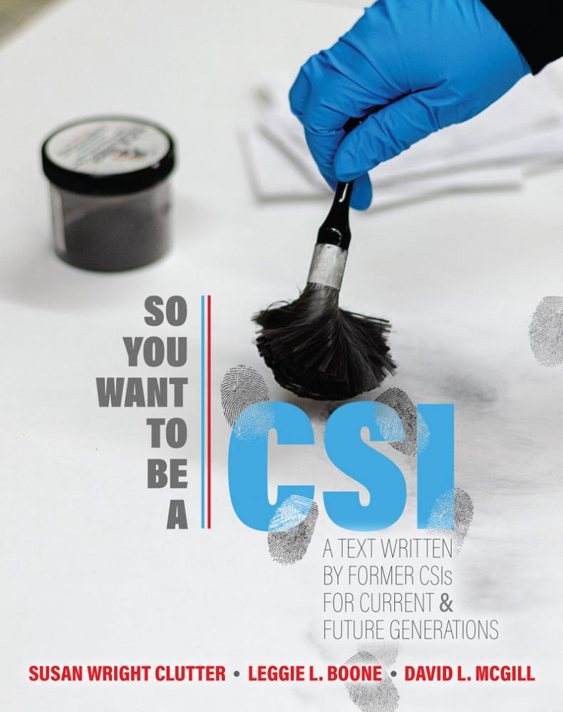
Criminal Justice
https://victory-xr.itch.io/kendall-hunt-csi-project

Slide 23
Criminal Justice

Slide 24
Criminal Justice
Victimology

Slide 25
Criminal Justice
CJ Research Methods

Slide 26
Criminal Justice

Slide 27
Criminal Justice

Slide 28
Criminal Justice

Slide 29
English
English Comp Reader-1st Semester

Slide 30
English
English Comp Reader- 2nd Semester

Slide 31
English
I have been using The Touchstone Anthony of Contemporary Creative Nonfiction for several years now. Finding this new anthology edited by Debra Monroe lends energy and newness to my teaching ahead. There are authors I know well, and ones I want to know. I can’t wait to use this book in my classes this next spring. I so love it.

Slide 32
Hospitality
Takeover from Pearson- Top Seller in Niche

Slide 33
Hospitality
Hospitality Sales with GoReact

Slide 34
Hospitality
Intro to Beverages

Slide 35
Hospitality

Slide 36
Hospitality

Slide 37
STEM

Slide 38
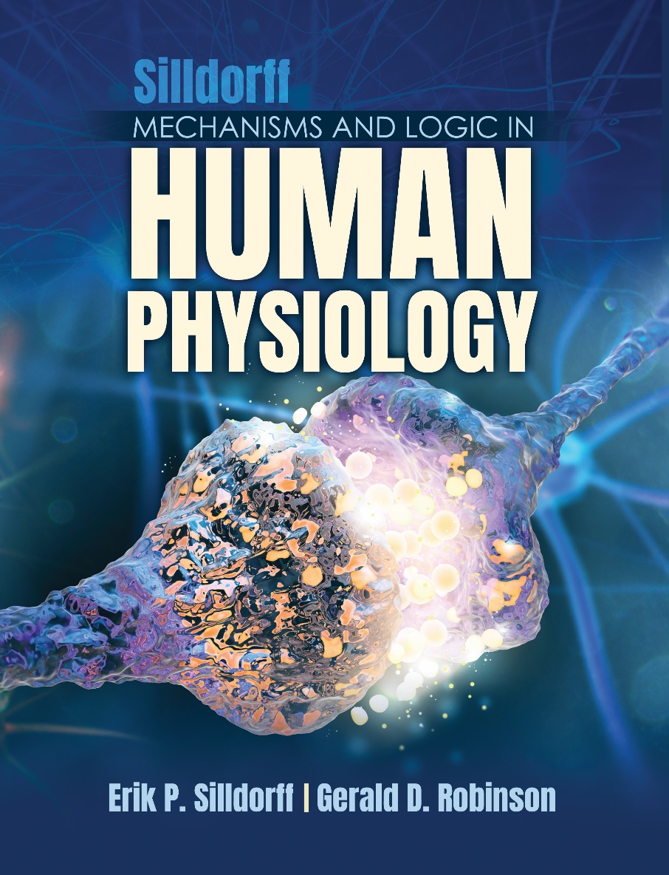
STEM

Slide 39
STEM

Slide 40
Zehr - Entrepreneurship
Jacobs Etal - Operations Management
Easterling - Supply Chain Management
Cuckovitch/Donald - Advertising (GRL)
Vaidyanathan/Leo - Operations Management
Lester/Lester - Organizational Behavior
Rymsha/Kahle-Piasecki - Leadership
Kim, Philips, Klatka, Opata, Suveiu, Austin and Branzei - International Business
(Austin and Branzei at Ivey/Western U)
Nagel - E Sports
Jacobs, Berg-Ridenour, Opata, Walker and Bodeman - Intro to Business

Slide 41
Getting the MOST out of an Adoption
How to Generate a National Lead
CRM leads
Current authors and adopters
Course Mapping
“What other courses do you teach?”
“Are there any new courses being developed?”
2. Send Product Suggestions
Send the direct link to the Kendall Hunt website
Review table of contents, overview and sample chapter (if available)
Mention instructor ancillaries that are included with an adoption
3. Follow Up
Did they review the TOC, overview and sample chapter?
Send eBook access
Send sample ancillary material

Slide 42
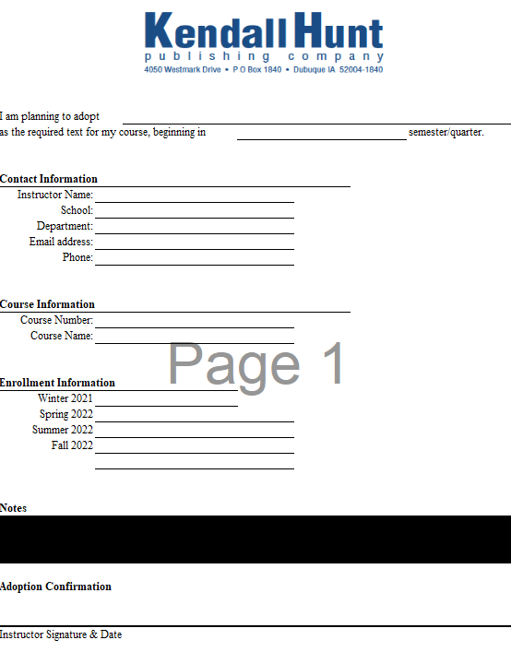
Getting the MOST out of an Adoption
4. Closing the Sale – Adoption Confirmation
Send adoption confirmation form
Send friendly URL
Are there other instructors teaching the course? Who is teaching other courses in the department?
Our success
5. Continued Communication – Establish the Relationship
Check In
Obtain feedback
What has changed?

Slide 43
Bringing the Sales Home
We will be discussing
The role of PSRs
Importance of CRM notes for all parties
Importance of post adoption steps
Tag-team sales effort

Slide 44
Bringing the Sales Home
610 A Jami | 610 B Deb
Communication | Composition/English
Criminal Justice | Education/Reading
General Business | FYE/Student Success
Pharmacy | Hospitality
Social Sciences | Music/Fine Arts
 | Science
 | Sport Management

Slide 45
Bringing the Sales Home
NBP Books that offer an ancillary package, GRL Website, Area9 or Publish 1st have been updated and are on the Third Solution Website.
https://kendallhunt.com/thirdsolution
Provide the new adopter with the book’s KH Website Friendly URL to be included in the course syllabus – stressing eBook
Send Adoption Confirmation Letter to the bookstore to let them know about the adoption of the textbook
Confirm with the bookstore the course enrollment and/or quantity ordered

Slide 46
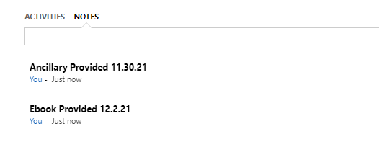
Bringing the Sales Home
CRM Notes & Tips
While working the lead, make sure the person is in CRM
If your records are not in CRM – they do not exist!
Record all notes and correspondence
Searching in CRM
Search the school, check the contacts for the title

Slide 47
Bringing the Sales Home
Tracking sales dollars
Once the adoption confirmation letter is received, we will be seeking the bookstore order or looking for DTSS sales
We will contact you to assist us if no order can be found for additional follow-up

Slide 48
Bringing the Sales Home
Have a great sales year!
Remember: we are all rowing in the same direction!

Slide 49
Field Adoptions
TOP PERFORMERS
ADOPTIONS CHAMPION: BETH SLAATS 20 ADOPTIONS
SECOND PLACE: TESSA DANIELS 13
THIRD PLACE: LINDSEY WYNNE 8
HONORABLE MENTION:
MARQUES JESSIE AND DANNY PINTO 6
IAN LAMOUREAUX, MELISSA LAVENZ, SEAN SKINNER AND SAM SMITH 5

